Slide 1
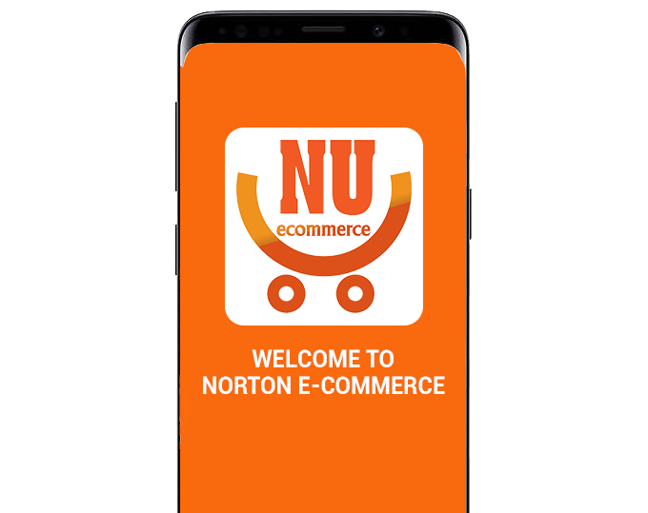
Norton E-commerce
Where Products and People are Connected
`

Slide 2
Contents
E-commerce and People
Introduction to NU E-Commerce
NU E-Commerce Features
Demo
Conclusion

Slide 3
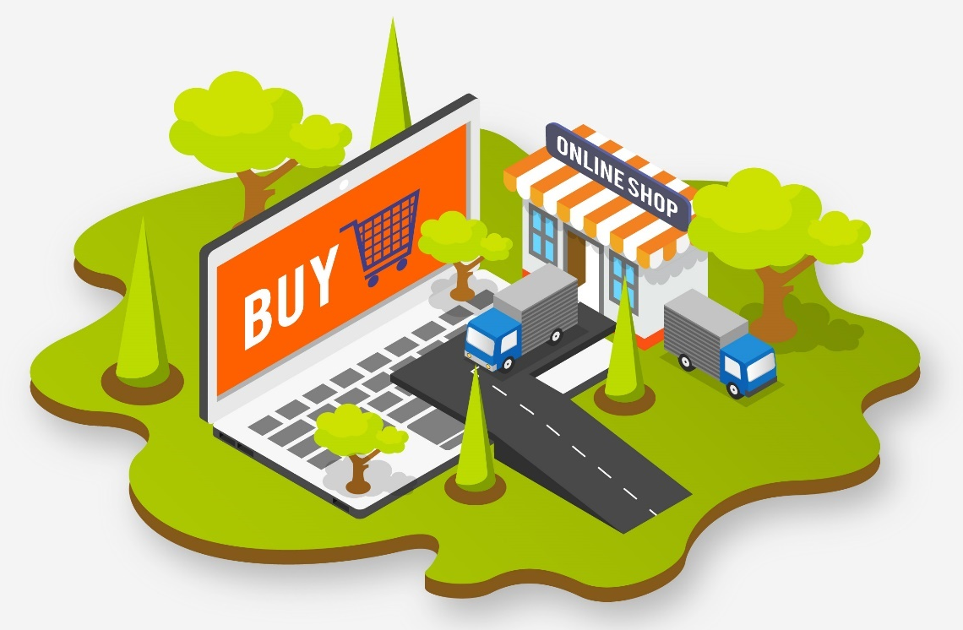
Introduction to E-commerce And People
A wireless relationship

Slide 4

E-commerce
Commonly known as Electronic Marketing.
Buying and selling goods or services over an electronic system such as the internet.

Slide 5

E-commerce and People
3.74 billion Internet users in the world as at March 2017.
95% of Americans shop online at least yearly.
People spend an average of 5 hours per week shopping online.
*Statistics according to www.internetworldstats.com

Slide 6

E-commerce and People (continue)
Only 35 percent of shoppers are willing to pay for delivery on online orders
Online Shoppers prefer to see the products before they pay
Shoppers prefer to have phone calls or direct contact with the seller, they think it’s more secure and more trust

Slide 7

Online shopping’s concerns
Slow communication with sellers
Not trustable, not enough information
Buyer difficult in finding good products and good quality
Seller difficult in finding his real buyer
Products reach wrong customers, not able to see by the users who want it
Complex login process, not intuitive UI

Slide 8
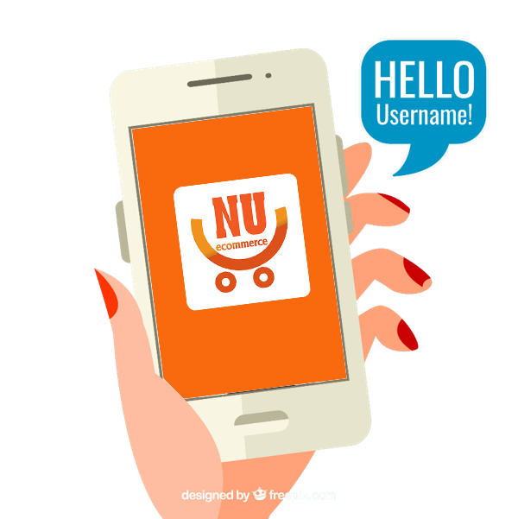
Introducing Norton E-commerce App
An app that connects products and people

Slide 9

We aim to…
Speed up trade communication
Make sure you have full info for you to decide
Take care of finding a right customer for your product, and a quality product for your needs
Ensure your product reach the right users
One click to use, no complex UI

Slide 10


Features of Norton E-Commerce App

Slide 11

One touch log in, no more password
Straight forward, a tap to use
Your phone number is your password
No more account registration process

Slide 12

Big place for all your items
Sell or buy your products with user-to-user market place
Descriptive, full information
Easy to contact your buyers or sellers with one click contact button

Slide 13

Related Suggestion, Quick ContactMe Button
Find relevant users for your products
With quick contact me button, you can quickly let the posts owner you have/need his products

Slide 14

Always get informed
When we found your product’s owner
When we found an item that you’ll need
When we found a related products that you may need

Slide 15
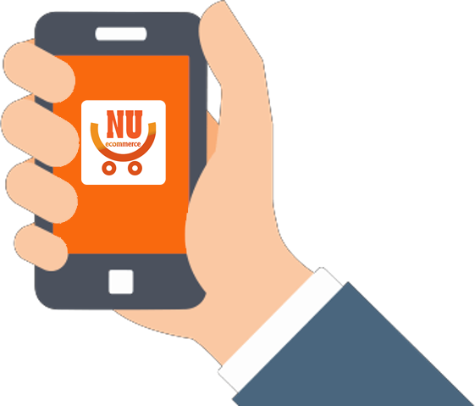

Demo of Norton E-Commerce App

Slide 16


Demo Video

Slide 17

Norton E-Commerce App
We aim to be your easy access selling and buying mobile platform
Focus to help you get your item sold or bought quickly as possible
Communication now more streamline and easy than ever
One click login, nothing more easy than that
Always keep alert about your products

Slide 18



Thank You!

